Slide 1
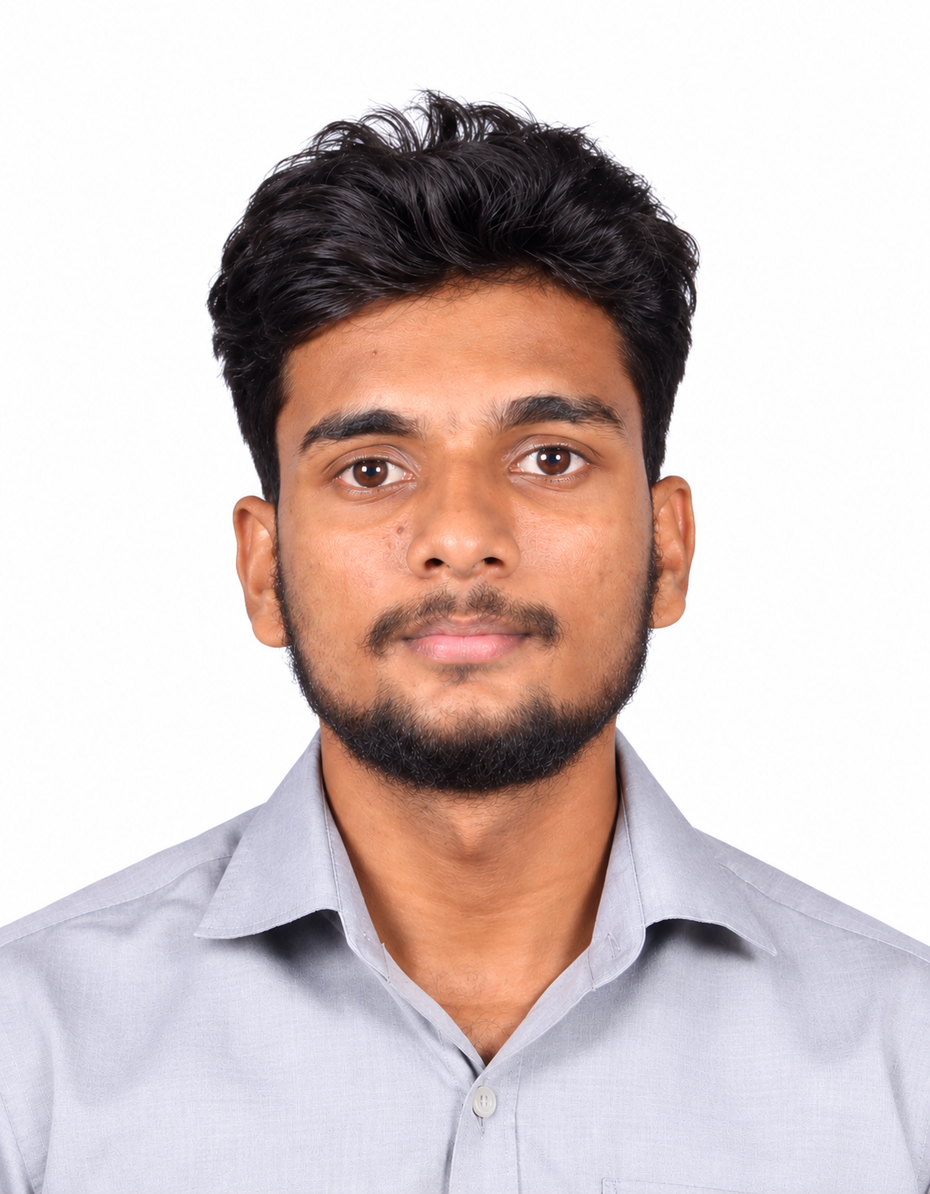
One year to turn strong fundamentals into real engineering.
Here for a one-year internship as part of my programme, to learn from the team, work on real projects and contribute wherever I can.
EDUCATION
Integrated M.Tech, Software Engineering
VIT Vellore · 5-year programme · Final year
Sanjay S
WHAT I WORK WITH
LANGUAGES
BUILD & RUN
EXPLORING
Software Engineer Intern
Python · Java
Cloud & DevOps
Agentic AI
MS/EAC11-EM
BEYOND CODE
Solo traveller, so I adapt quickly. Football player, so I'm team-first.

